Slide 1
Directions to the instructor
As the Pennsylvania Fire Service moves in a digital direction of having a mandated Firefighter Registry, Vector Solution’s Acadis Readiness Suite will be the tool of choice.
The PA State Fire Academy will use the local level training system to begin capturing firefighters for inclusion in the system.
This PowerPoint covers the three phases necessary in order to properly register firefighters. The three phases are:
FEMA SID Request
Acadis Portal Request
Profile Management
As the instructor, you will need to allow a period to elapse between the three phases. This time is indicated on the ‘section information slide’.
The project information slide (slide #2) and FEMA SID Request (slide #3) should be completed within the first hours of the class.

Slide 2
The Acadis Learning Management System
The primary goal of the Firefighter registration project is to identify and record all Firefighters who are associated with Pennsylvania Emergency Services organizations.
Other benefits registrants can expect:
The ability to view and register for State Fire Academy Alternative Energy, Academy on the Road, and Resident programs
View your enrollment and waitlist status for Fire Academy Programs
Print your training transcript, as well as duplicate certificates for programs that were delivered by the Fire Academy
View Statewide Certification testing opportunities
Share your training history with your organization's training officer
Participate in online training opportunities
The registration process requires three phases. The first is to acquire a FEMA SID number. If you already have one but do not know what it is: you can recover it on the request page.

Slide 3
FEMA SID
CDP.DHS.Gov/FEMASID

Slide 5
Section Information Slide
Anticipate 24 to 48 hours from the time the FEMA SID has been requested until the student receives a response.
The next four slides will cover the portal request.
Remind students they will receive an email from Acadisonline.com. Some spam filters have not allowed this email to be delivered to the user’s inbox.

Slide 6
Fire Academy Portal
PSFA.ACADISONLINE.COM

Slide 7
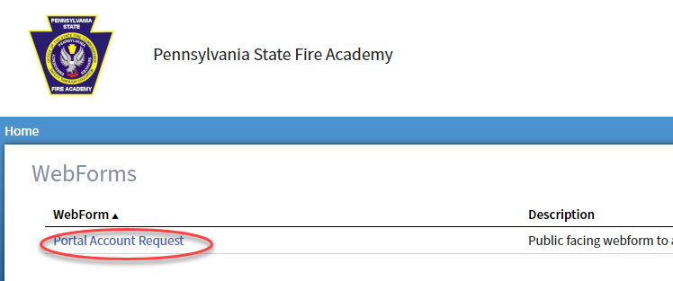
Accessing the Request Form
CLICK ON THE PORTAL ACCESS REQUEST LINK
Click Here

Slide 8
Complete The Request Form
Please allow up to 96 hours for your account to be established.
Review your SPAM folder for a response from the system. The email will come from Acadisonline.com

Slide 9
NEED Help ?
RA-EMPSFAACADISHELP@PA.GOV

Slide 10
Project Information
Students should expect a delay of up to 96 hours from the time they request the portal account until it is established. After which, it should be safe to show the slides for the final phase.
Encourage students to keep their information up to date.
The first slide is the information the student can change without the system reviewing it.
The second slide is information the student can update but will need to be reviewed first.
Finally, for students that have been in the training system previously encourage them to review the information on their record.
Certifications issued by any entity other than the FIRE ACADEMY are not in the system but in the future that may change
If the information in the student’s record is inaccurate, please encourage them to use the help email.

Slide 11
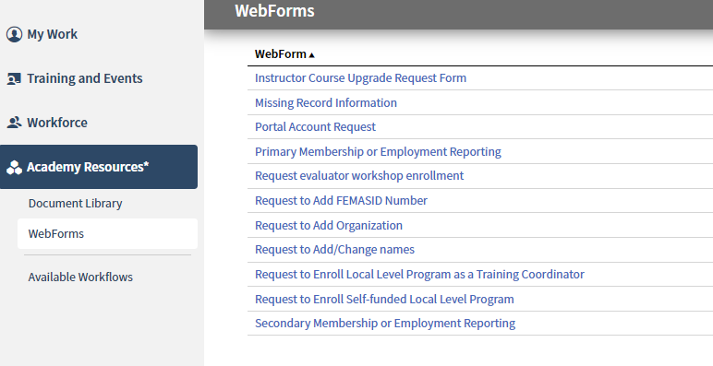
Keeping your Information up to DATE
The updates below will occur almost immediately
These will require a system review before the updates occur.

Slide 12
NEED Help ?
RA-EMPSFAACADISHELP@PA.GOV

